Slide 1


Automated Visual Regression Testing because….
CSS
IS
AWESOME
Notes:
Spotify music

Slide 2
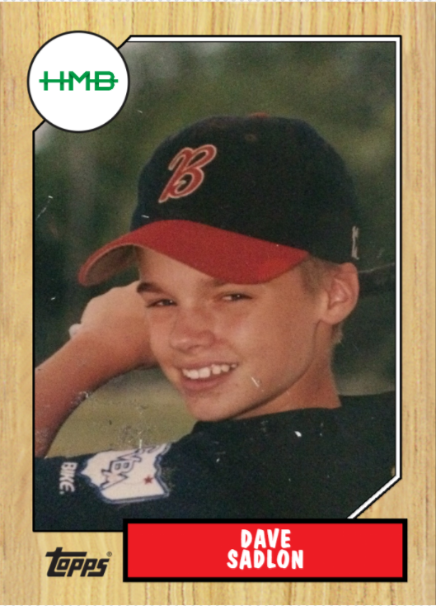
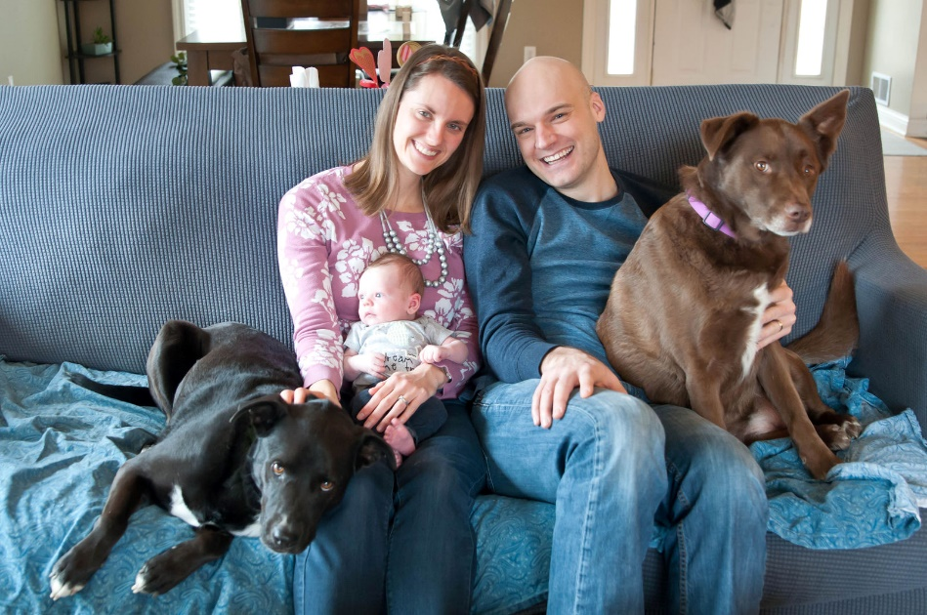
Now Batting…
Dave Sadlon
Testing Services Director @ HMB
12 Years in IT Industry
Cleveland Indians Fan
Avid Hiker

Slide 3
What this talk is about
Learning from getting hit by pitches
What is automated visual regression testing
When to use automated visual regression testing
Available Libraries – and using them
Further capabilities of automated visual regression testing
4
Notes:
What is Automated Visual Regression Testing
When to use Automated Visual Regression Testing
Leveraging the Backstop.js Library
Further Capabilities of Automated Visual Regression Testing

Slide 4
What this talk is NOT about
Learning from getting hit by pitches
Best UI/UX Practices
Refactoring CSS
“Functional” Automated Testing (Ruby/Cucumber, Selenium etc.)
4
Notes:
Best UI/UX Practices
Refactoring CSS
“Functional” Automated Testing (Ruby/Cucumber, Selenium etc.)
Best Practices for Testing

Slide 5
Every Session has a Story
Our Box Score
Rewrite of customer facing websites – Fortune 500 company
Project that had two components
.NET based CMS & Custom .NET MVC “Portal”
Project had been handed off to us after failed attempt
Content was being built while build phase was going on
4
Notes:
Rewrite of Customer Facing Websites – Fortune 500 company
Project that had two components
.NET based CMS & Custom .NET MVC “Portal”
Project had been handed off to us after failed attempt
Content was being built while build phase was going on

Slide 6

The Starting Lineup
3

Slide 7
Bad News Bears
Project Team Starting Lineup
1. .NET Developers*
2. CMS Developers*
3. Business Analyst
4. Design Team*
5. Content Managers*
6. Product Owner
7. Project Manager
8. Solution Architect
9. DevOps/Test QA Lead
3
Notes:
I was the QA Devops
*the key players of this story

Slide 8



Well-Oiled Machine
Manual Tests
E2E
Integration
Unit
https://martinfowler.com/bliki/TestPyramid.html
2
Notes:
70/20/10

Slide 9
Breaking up the No-Hitter
5

Slide 10




Breaking up the No-Hitter
I’m Contenting
Refactor!
CSS
There’s little risk
Content Manager
Still Building
Developer
(Refactoring CSS)
Rounded Corners!
Designer
Changing Design
5
Notes:
Developer wanted to refactor CSS
Designer wanted to make some “minor updates”
Content Manager was still building out content
My Tester Sense was going crazyyyy

Slide 11


Little Risk….
There’s little risk of me flying past this baseball game
3
Notes:
Risk is an interesting thing
In 20 years an asteroid may hit the earth but the risk is low….uhhhh what that can end the world!!!
In honor of opening day – I present the worst risk estimated situation

Slide 12
Breaking up the No-Hitter
I’m Contenting
Refactor!
CSS
Why does the site look horrible now !?!?!
…. 2 Days Later
Content Manager
Developer
Rounded Corners!
Designer
2
Notes:
…..2 days later

Slide 13
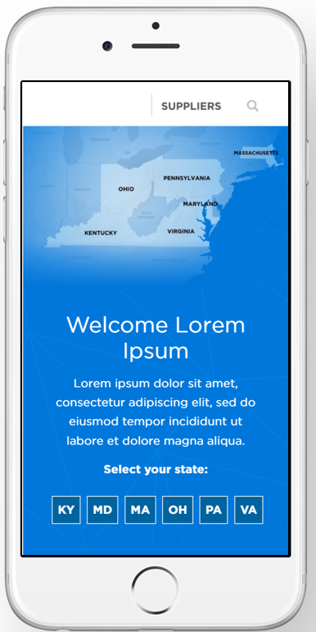
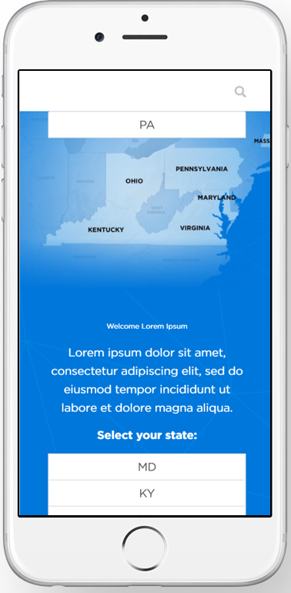
Breaking up the No-Hitter
7

Slide 14
Breaking up the No-Hitter
Manual Tests
E2E
Integration
Unit
https://martinfowler.com/bliki/TestPyramid.html
1
Notes:
JENKINSSSSSS I TRUSTED YOU

Slide 15

Visit to the mound
TESTING!
TESTING!
Content Manager
Test Lead
Developer
TESTING!
Designer
6
Notes:
Star wars – the imperial march

Slide 16
Call to the Bullpen
We need a reliever
Jenkins was reporting everything passing
Validating the UI manually every time was too time consuming
(7 site instances x ~50 pages per = 350 pages)
Ultimately we just wanted to know if something changed the UI
4

Slide 17
Call to the Bullpen
We need a reliever
How can we speed up UI regression review process?
Include it in our CI
Visually inform us of changes
Cost Effective
4

Slide 18

Error – Test Lead
Pride got the best of me
Custom Build +
BrowserStack +
ImageMagik Library +
Had to align images perfectly =
Hot Garbage
6

Slide 19
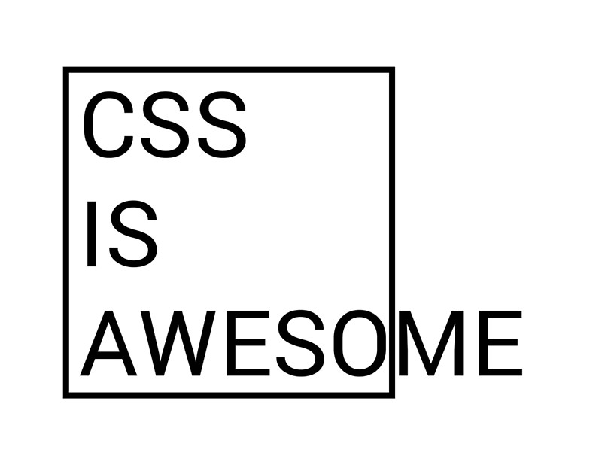
Pinch Hitter
We need a clutch hit
Stop…Collaborate and listen
CSS is easy to break and hard to test
Friend recommended to look into Visual Regression Testing
4

Slide 20
Automated Visual Regression Testing
What is it?
Perform front-end or user-interface(UI) regression testing by capturing the screenshots of web pages/UI and compare them with the original images (either historical baseline screenshots or reference images from live website)
https://saucelabs.com/blog/getting-started-with-visual-regression-testing-using-intern-and-sauce-labs
4
Notes:
Ultimately it is the ability to verify changes to the user interface are expected

Slide 21
Automated Visual Regression Testing
Compares DOM screenshots over time
A diff for web elements
Compare against an approved styling
Falls on the outside of the pyramid
Visual Regression
Manual Tests
E2E
Integration
Unit
4
Notes:
Compares DOM screenshots over time – a nice “source control”
A diff for web elements
Compare against an approved styling – talk a little bit more
Falls on the outside of the pyramid

Slide 22


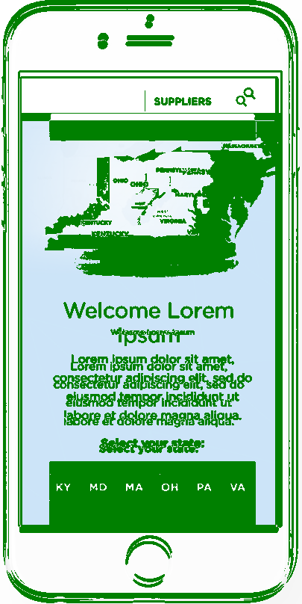
Automated Visual Regression Testing
7
Notes:
A visual representation of what changes

Slide 23
Calling Pitches
What did I decide
PhantomCSS - https://github.com/HuddleEng/PhantomCSS
Selenium + other tools (webdriver, phantomcss)
gemini + browserstack - https://github.com/gemini-testing/gemini
BackstopJS - http://backstopjs.org
Applitools - https://applitools.com
4
Notes:
What did I evaluate to use
PhantomCSS - https://github.com/HuddleEng/PhantomCSS
BackstopJS - http://backstopjs.org
Selenium + other tools (webdriver, phantomcss)
gemini + browserstack - https://github.com/gemini-testing/gemini

Slide 24
Shaking Off Pitches
What did I decide
PhantomCSS – No longer maintained
Selenium + other tools (webdriver, phantomcss) – Been there
gemini + browserstack – Requires webdriver, slower
BackstopJS – active, headless, simple, efficient
Applitools – still in beta at the time of this project
4
Notes:
Evaluation of why we made the decisions we did
PhantomCSS – No longer maintained
Selenium + other tools (webdriver, phantomcss) – Been there
gemini + browserstack – Requires webdriver, slower
BackstopJS – active, headless, simple, efficient

Slide 25




BackstopJS
The Details
Chrome Headless
BackstopJS
CasperJS
4
Notes:
1. Chrome Headless - headless browser
headless browser = a browser without a GUI.
2. CasperJS - simulate user behavior
A scripting tool that allows us to interact with the page rendered by PhantomJS just like a user would: moving a mouse, performing clicks, entering text into input fields, and any other user actions you define on it.
3. ResembleJS - tell me the difference
This is the actual "diffing" tool itself, comparing two images and to determine pixel differences between them.

Slide 26
A long list
Name | Platform | Programming Language
Applitools Eyes | Selenium & Other | All
Fighting Layout Bugs | Selenium | Java
Selenium Visual Diff | Selenium | Java
CSS Critic | Other | JavaScript
Gemini | Selenium | JavaScript
Grunt PhotoBox | PhantomJS | JavaScript
PhantomCSS | PhantomJS & Resemble.js | JavaScript
Snap and Compare | PhantomJS | JavaScript
Specter | XULRunner | JavaScript
WebdriverCSS | Selenium | JavaScript
FBSnapshotTestCase | Other | Objective-C
VisualCeption | Selenium | PHP
dpdxt | PhantomJS | Python
Huxley | Selenium | Python
Needle | Selenium | Python
Wraith | PhantomJS | Ruby
Wraith-Selenium | Selenium | Ruby
4
Notes:
Evaluation of why we made the decisions we did
PhantomCSS – No longer maintained
Selenium + other tools (webdriver, phantomcss) – Been there
gemini + browserstack – Requires webdriver, slower
BackstopJS – active, headless, simple, efficient

Slide 27

Automated Visual Regression Testing
Disclaimer
Using a tool doesn’t equal good testing
Using the right tool properly is key
4

Slide 28
BackstopJS Workflow
backstop init Set up a new BackstopJS instance
backstop test BackstopJS creates a set of test screenshots and compares them with your reference screenshots.
backstop approve If the test you ran looks good, then go ahead and approve it. Approving changes will update your reference files with the results from your last test.
4
Notes:
The backstop workflow
backstop init: Set up a new BackstopJS instance
backstop test: BackstopJS creates a set of test screenshots and compares them with your reference screenshots.
backstop approve: If the test you ran looks good, then go ahead and approve it. Approving changes will update your reference files with the results from your last test.

Slide 29
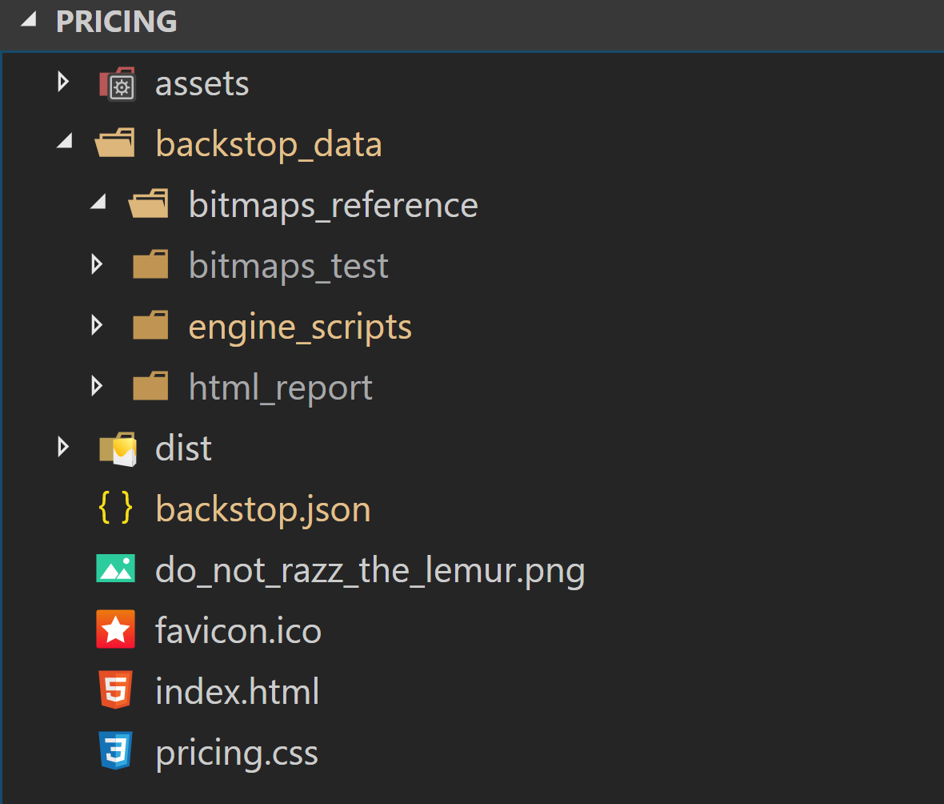
Backstop_data
4
Notes:
The backstop workflow
backstop init: Set up a new BackstopJS instance
backstop test: BackstopJS creates a set of test screenshots and compares them with your reference screenshots.
backstop approve: If the test you ran looks good, then go ahead and approve it. Approving changes will update your reference files with the results from your last test.

Slide 30
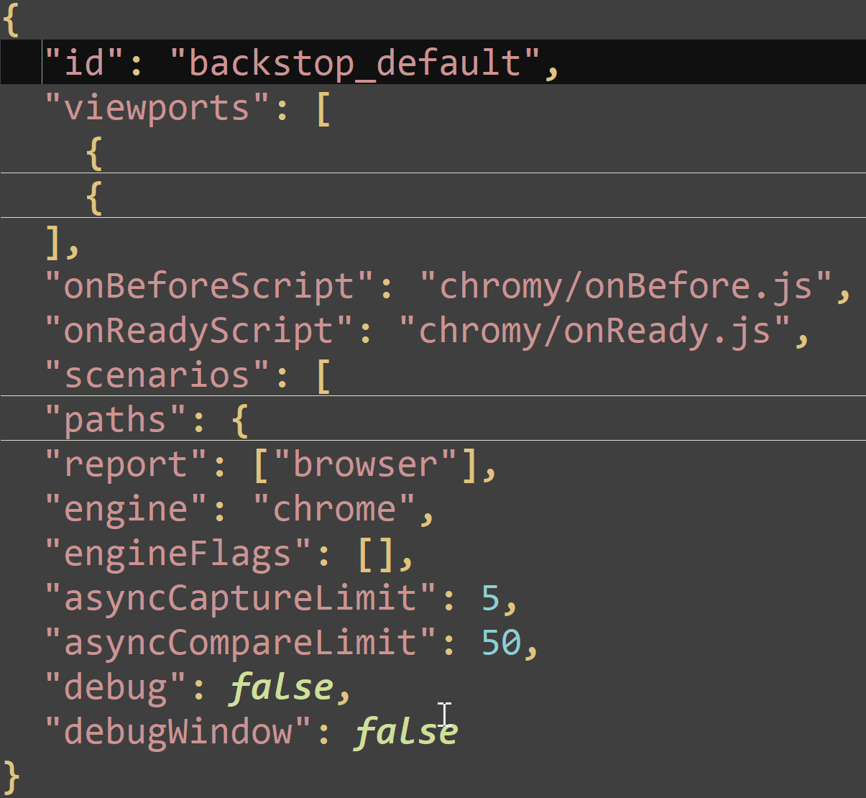
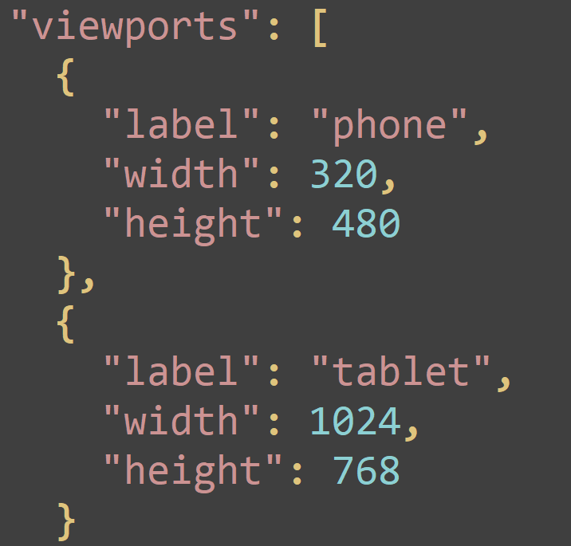
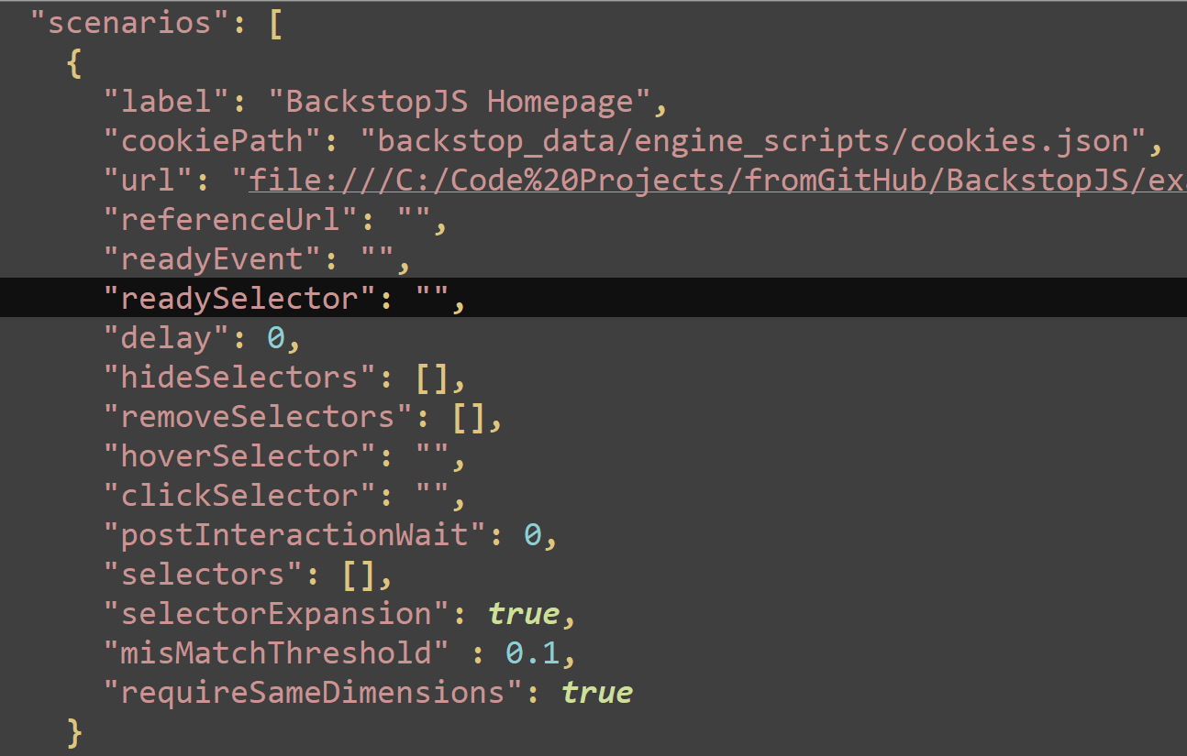
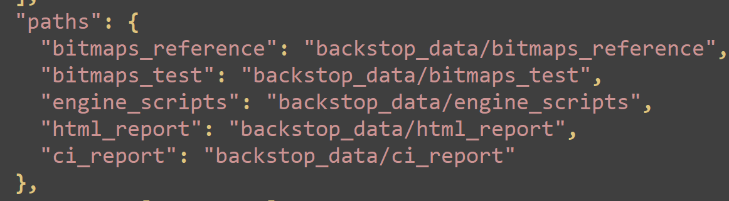
BackstopJS json
4
Notes:
The backstop workflow
backstop init: Set up a new BackstopJS instance
backstop test: BackstopJS creates a set of test screenshots and compares them with your reference screenshots.
backstop approve: If the test you ran looks good, then go ahead and approve it. Approving changes will update your reference files with the results from your last test.

Slide 31
BackstopJS Demo
BackstopJS Node Package already installed - npm install -g backstopjs
Run Initial BackstopJS config - backstop init
Run BackstopJS Test – backstop test
Approve Changes – backstop approve
4
Notes:
Remember web page is already open
BackstopJS Node Package already installed - npm install -g backstopjs
Run Initial BackstopJS config - backstop init
Run BackstopJS Test – backstop test
Approve Changes – backstop approve
Open VS Code

Slide 32
BackstopJS init
4
Notes:
The backstop workflow
backstop init: Set up a new BackstopJS instance
backstop test: BackstopJS creates a set of test screenshots and compares them with your reference screenshots.
backstop approve: If the test you ran looks good, then go ahead and approve it. Approving changes will update your reference files with the results from your last test.

Slide 33
backstop test command
Compares reference images to current site
Determines failure based on configured threshold
Creates version history
Produces report
4
Notes:
The backstop workflow
backstop init: Set up a new BackstopJS instance
backstop test: BackstopJS creates a set of test screenshots and compares them with your reference screenshots.
backstop approve: If the test you ran looks good, then go ahead and approve it. Approving changes will update your reference files with the results from your last test.

Slide 34
backstop approve command
With no added parameters – accepts all
Replaces referenced
--filter=<regex>
Approve only those defined tests
4
Notes:
The backstop workflow
backstop init: Set up a new BackstopJS instance
backstop test: BackstopJS creates a set of test screenshots and compares them with your reference screenshots.
backstop approve: If the test you ran looks good, then go ahead and approve it. Approving changes will update your reference files with the results from your last test.

Slide 35
Advanced BackstopJS
BackstopJS ships with an onBefore script
BackstopJS makes it easy to capture screenshots of your entire layout or just parts of your layout with selectors attribute
Testing PWA, SPAs, & AJAX Content
BackstopJS solves this problem with two config properties: readySelector, readyEvent and delay.
4
Notes:
BackstopJS ships with an onBefore script
BackstopJS makes it easy to capture screenshots of your entire layout or just parts of your layout with selectors attribute
Testing PWA, SPAs, & AJAX Content
BackstopJS solves this problem with two config properties: readySelector, readyEvent and delay.

Slide 36
BackstopJS v 3
The Details of Version 3
Integrated Docker rendering -- to eliminate cross-platform rendering shenanigans
CLI reports
Simulate user interactions with Puppeteer and ChromyJS scripts
Run globally or locally as a standalone package app or require('backstopjs') right into your node app
4
Notes:
Integrated Docker rendering -- to eliminate cross-platform rendering shenanigans
CLI reports
Render tests with Chrome Headless
Simulate user interactions with Puppeteer and ChromyJS scripts
JUnit reports
Plays nice with CI and source control
Run globally or locally as a standalone package app or require('backstopjs') right into your node app

Slide 37
Implementing BackstopJS
What did we do
Using js-webcrawler – pull all pages across 7 instances
Integrated into Jenkins - "report" : [ "CI" ]
Reviewed Failures instead of every page – TIME SAVER
Loaded in style guide as reference and focused on specific elements
4
Notes:
What did we do to expand our project
Using js-webcrawler – pull all pages across 7 instances
Integrated into Jenkins - "report" : [ "CI" ]
Reviewed Failures instead of every page
Loaded in style guide and focused on specific elements
SelectorExpansion

Slide 38
Further capabilities
Looking into the future
Living UI Documentation of web application
Implement with Machine Learning
Incorporate as part of functional testing
Integrate with SASS browser provider (Sauce Labs/Browserstack)
4
Notes:
Recommended bask practices implementing Automated Visual Regression Testing
1. Name your screenshots
2. Don’t try to test everything
3. Full page screenshots are a bad idea
4. Scaling visual regression testing
5. Got a pattern library? make those elements/components your reference screenshots.

Slide 39
Best Practices for AVRT
Best Practices
1. Name your screenshots
2. Don’t try to test everything
3. Full page screenshots are a bad idea – focus on elements
4. Scaling visual regression testing – Use Source Control
5. Got a pattern library? make those elements/components your reference screenshots.
4
Notes:
Recommended bask practices implementing Automated Visual Regression Testing
1. Name your screenshots
2. Don’t try to test everything
3. Full page screenshots are a bad idea
4. Scaling visual regression testing
5. Got a pattern library? make those elements/components your reference screenshots.

Slide 40
When not to use AVRT
Screenshot approach is not optimal for testing live dynamic content
Scope of browser support
BS.js - Limited to Webkit (Chrome) and Gecko (Firefox)
When you have not built any Unit Tests
Please build Unit Tests
4
Notes:
Screenshot approach is not optimal for testing live dynamic content
Scope of browser support
BS.js - Limited to Webkit (Chrome) and Gecko (Firefox)
When you have not built any Unit Tests

Slide 41
What this talk was about
Learning from getting hit by pitches
What is automated visual regression testing
When to use automated visual regression testing
Leveraging the Backstop.js library
Further capabilities of automated visual regression testing
4
Notes:
NEXT SLIDE IS LAST
WHAT WE TALKED ABOUT
What is Automated Visual Regression Testing
When to use Automated Visual Regression Testing
Leveraging the Backstop.js Library
Further Capabilities of Automated Visual Regression Testing

Slide 42
Ballgame!
Game Recap
If there’s one thing to remember about this…
CSS is easy to break and HARD to TEST
and always remember that…
4
Notes:
If there’s one thing to remember about this…
CSS is easy to break and HARD to TEST
and always remember that…

Slide 43



Thanks!
Where to find me
@DSadgrass
http://bit.ly/SadlonLinkedIn
dsadlon@hmbnet.com
Questions?
4
Notes:
Remember to mention feedback form contest

